Slide 1


Slide 2
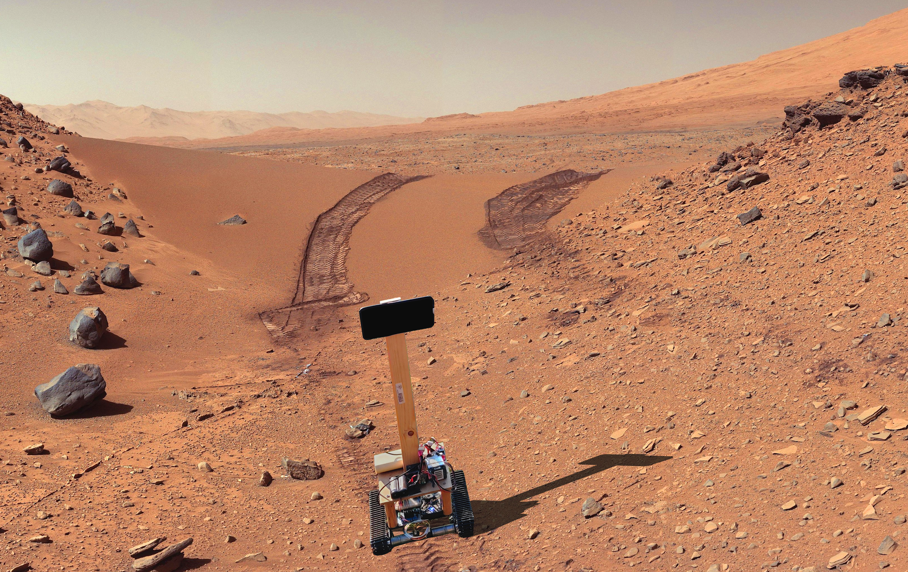

Slide 3
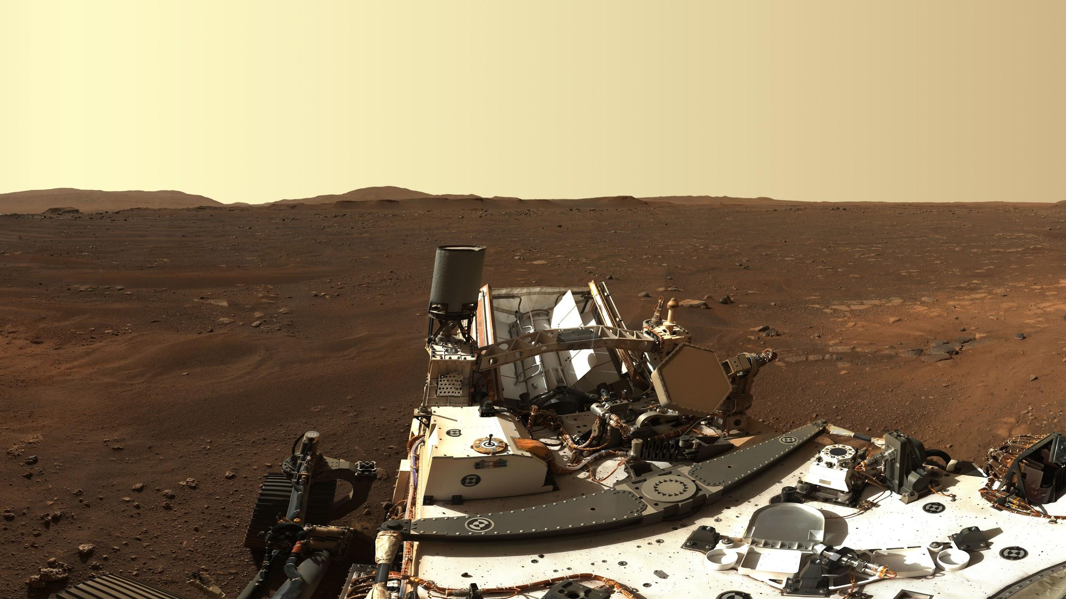


Slide 4
Autonomously Following Forest Paths with a Mobile Robot using Semantic Segmentation
Pieter Fiers r0708591
Simon Germeau r0708896
paddy.pfiers.net

Slide 5
Table of contents
Customer
Model
Rover
Conclusion

Slide 6

Droneport Sint-Truiden
Drone Surveying (agriculture, insurance, construction...)
Rover kit, motoren, batterijen
Notes:
Droneport: hub voor alles drone:
Skeyes luchtverkeersleider drone afdeling
Imec
DJI
AiRobot:
BVLOS: Beyond Visual Line-of-site
Landbouw en constructie

Slide 7
Model

Slide 8
Prior art
Giusti et al. A Machine Learning Approach to Visual Perception of Forest Trails for Mobile Robots
Smolyanskiy et al. Toward Low-Flying Autonomous MAV Trail Navigation using Deep Neural Networks for Environmental Awareness

Slide 9
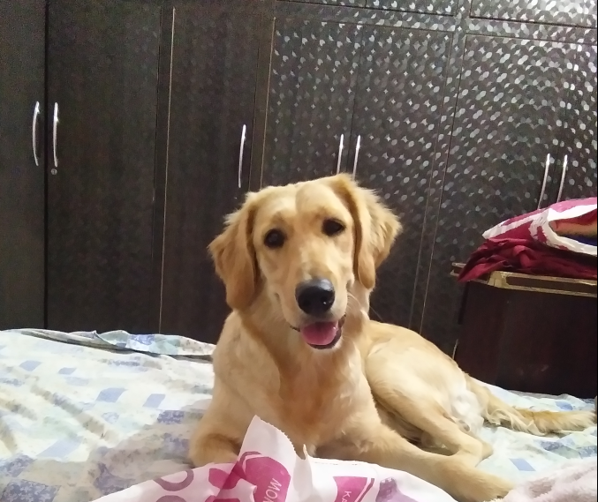
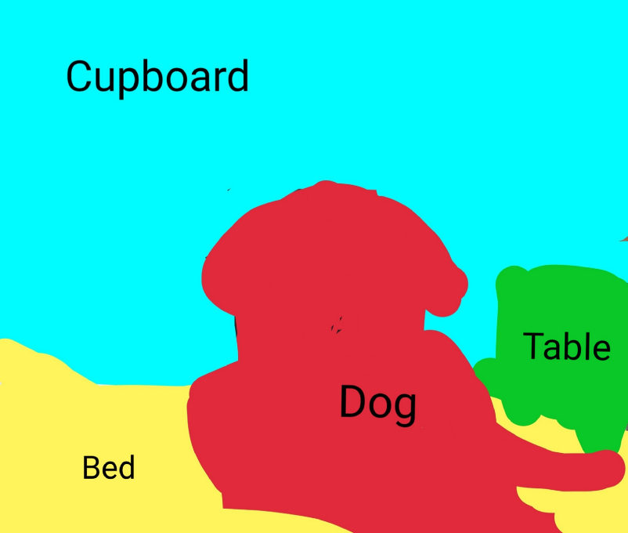
Semantic segmentation
Is a pixel road or not?
Mask
Garima Nishad

Slide 10
Datasets
Freiburg (Deepscene)
Giusti (Switzerland)
Steentjes

Slide 11
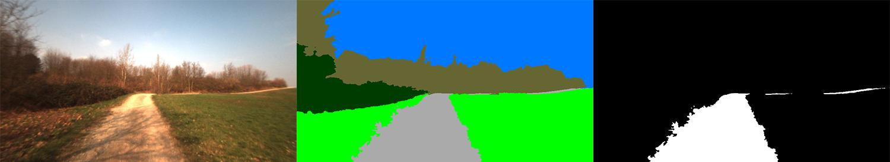
Freiburg (DeepScene)
deepscene.cs.uni-freiburg.de

Slide 12
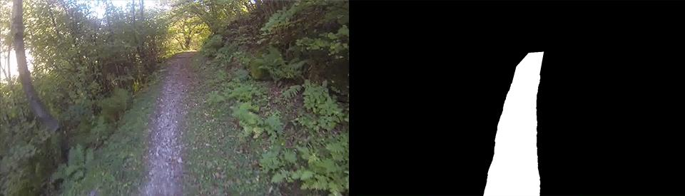
Giusti
people.idsia.ch/~giusti/forest/web/

Slide 13

Steentjes
Steentjesbos Kampenhout

Slide 14
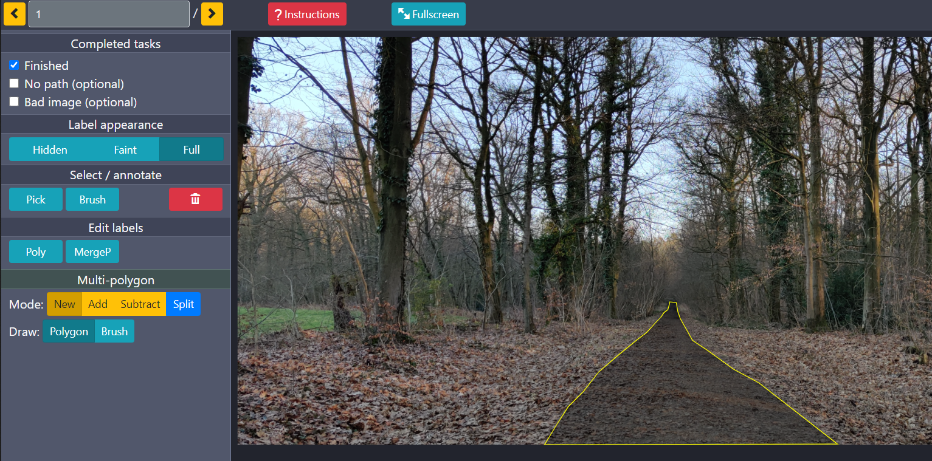
Labeling tool
Crowd sourced data
Json to mask
drone-label.pfiers.net
Django-labeller, Britefury

Slide 15
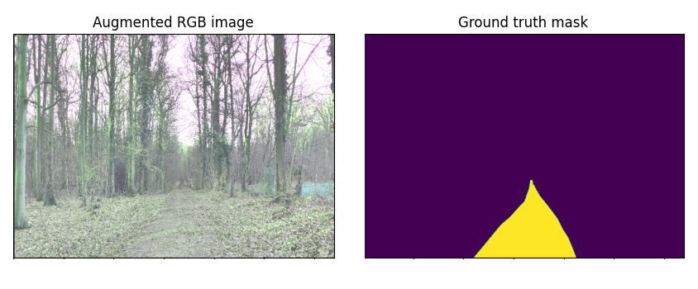
Augmentations
Not enough data
Randomizer
Hue, flip, crop....

Slide 16
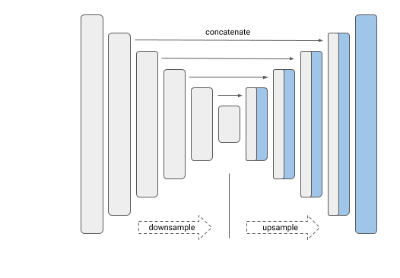
Model
Unet
EfficientNetB3
Tensorflow (Keras)
Segmentation models

Slide 17

Transfer learning
Headstart
2012 ILSVRC ImageNet
Imagenet

Slide 18
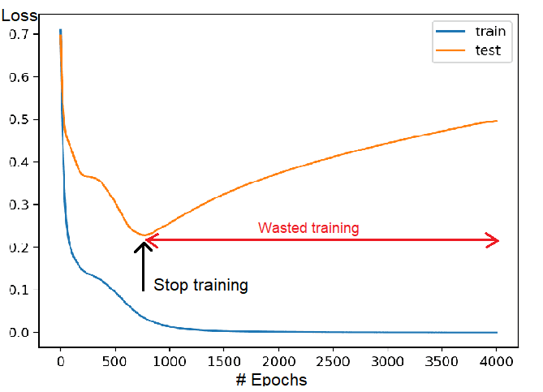
Training
70% Training 15% Validation 15% Test
Batch size = 16
Early stopping
Loss = Dice + Binary focal

Slide 19
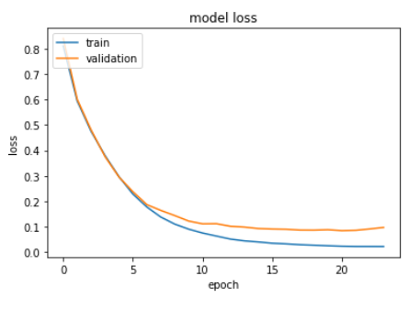
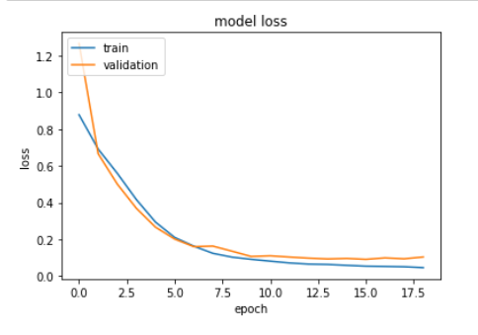
Freiburg
No aug
Aug

Slide 20
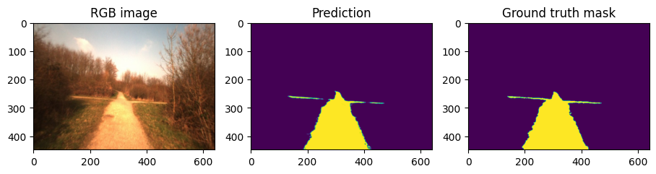
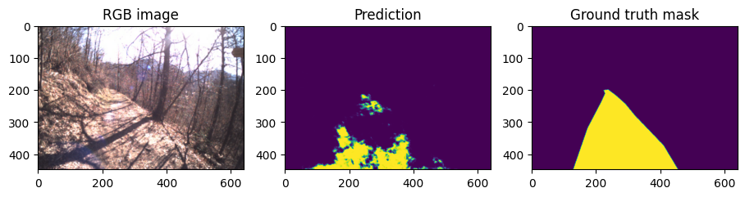
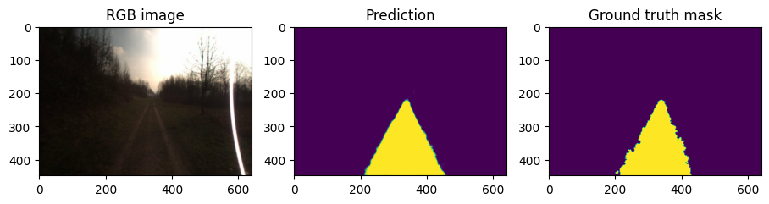
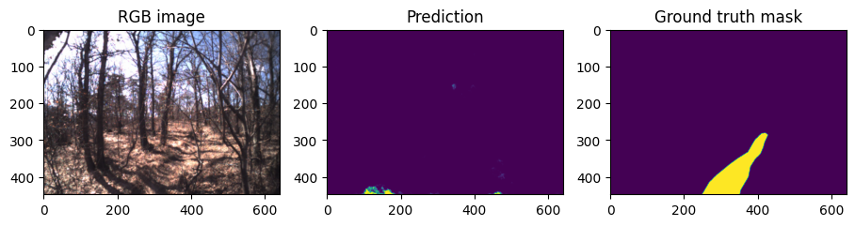
Freiburg results

Slide 21
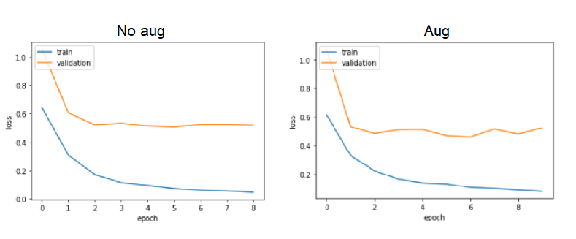
Giusti

Slide 22
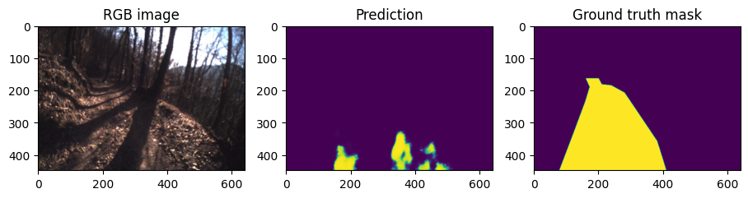
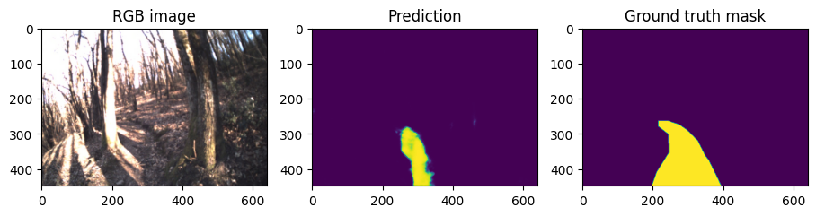
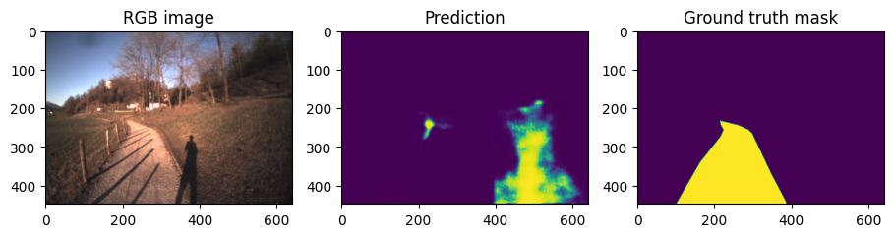
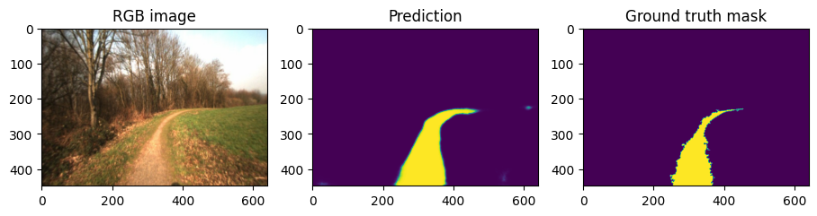
Giusti results

Slide 23
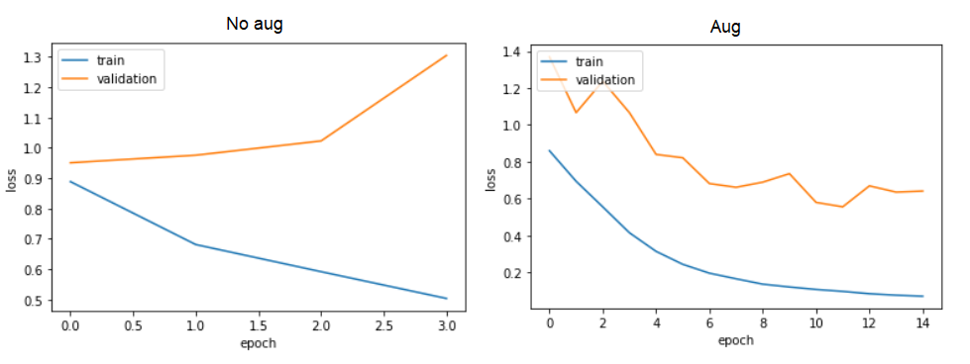
Steentjes

Slide 24
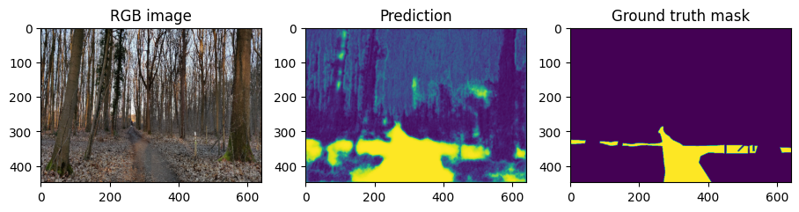
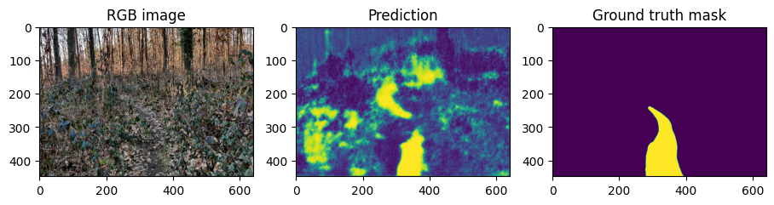
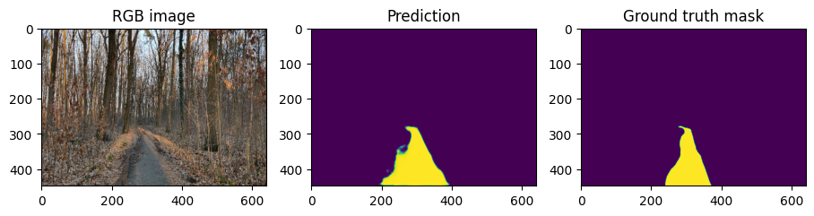
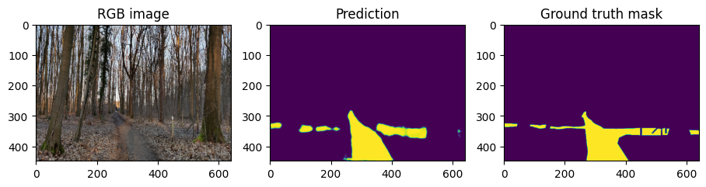
Steentjes results

Slide 25
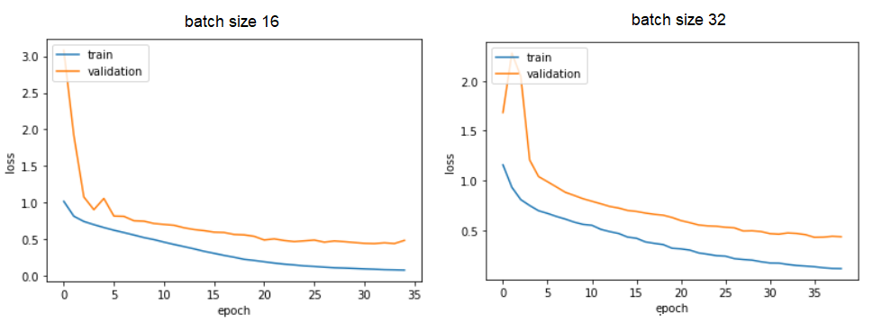
Freiburg + Giusti + Steentjes

Slide 26
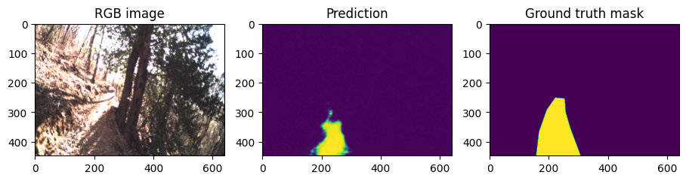
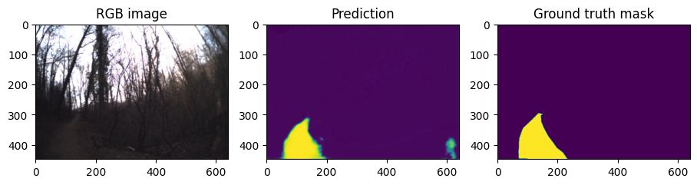
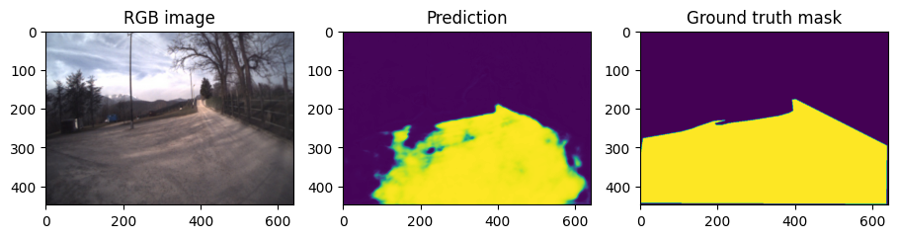
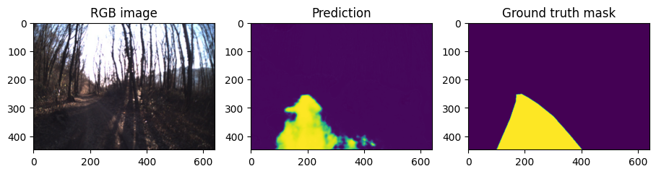
Freiburg + Giusti + Steentjes results

Slide 27
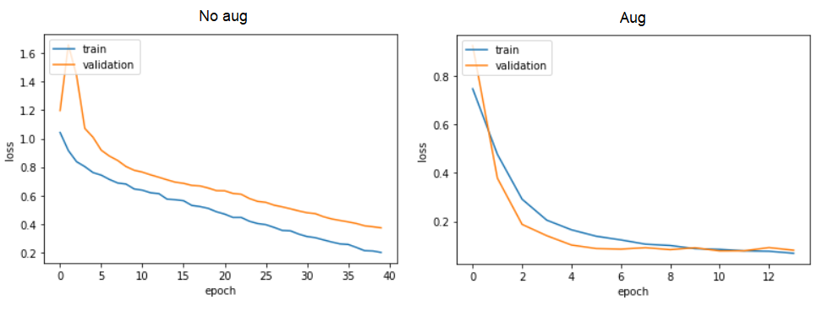
Freiburg + Steentjes

Slide 29
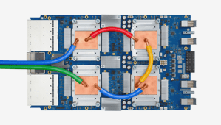
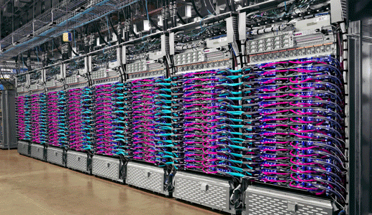
TPU
Google Cloud Platform
Machine Learning ASIC
Can’t run python code
Google Cloud Platform
Google Cloud Platform

Slide 30
Rover

Slide 31
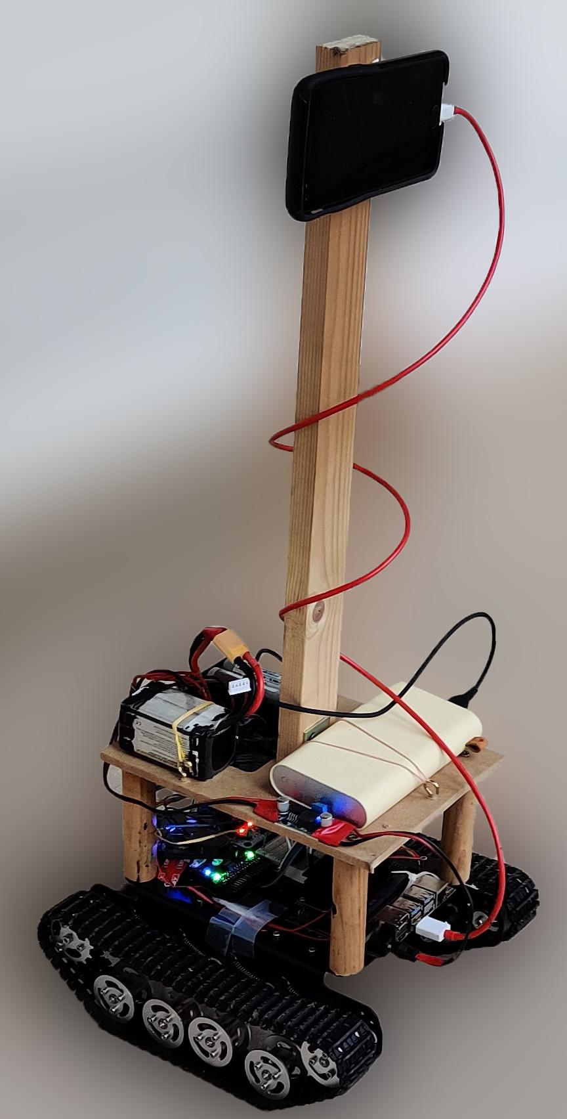

Slide 32
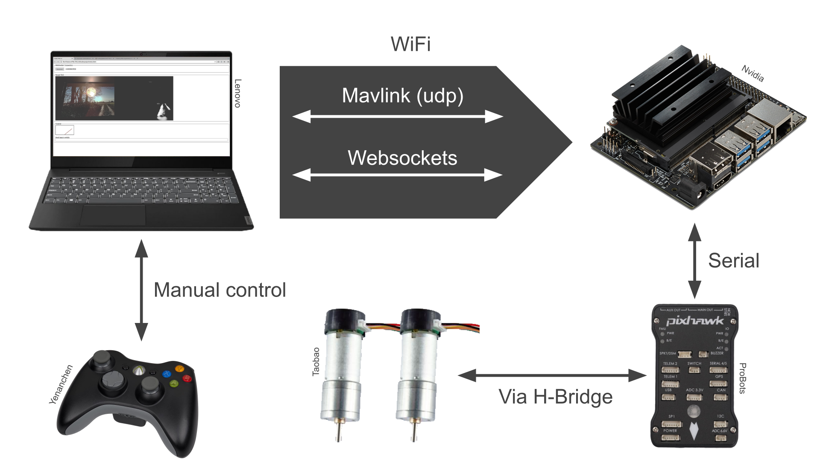

Slide 33
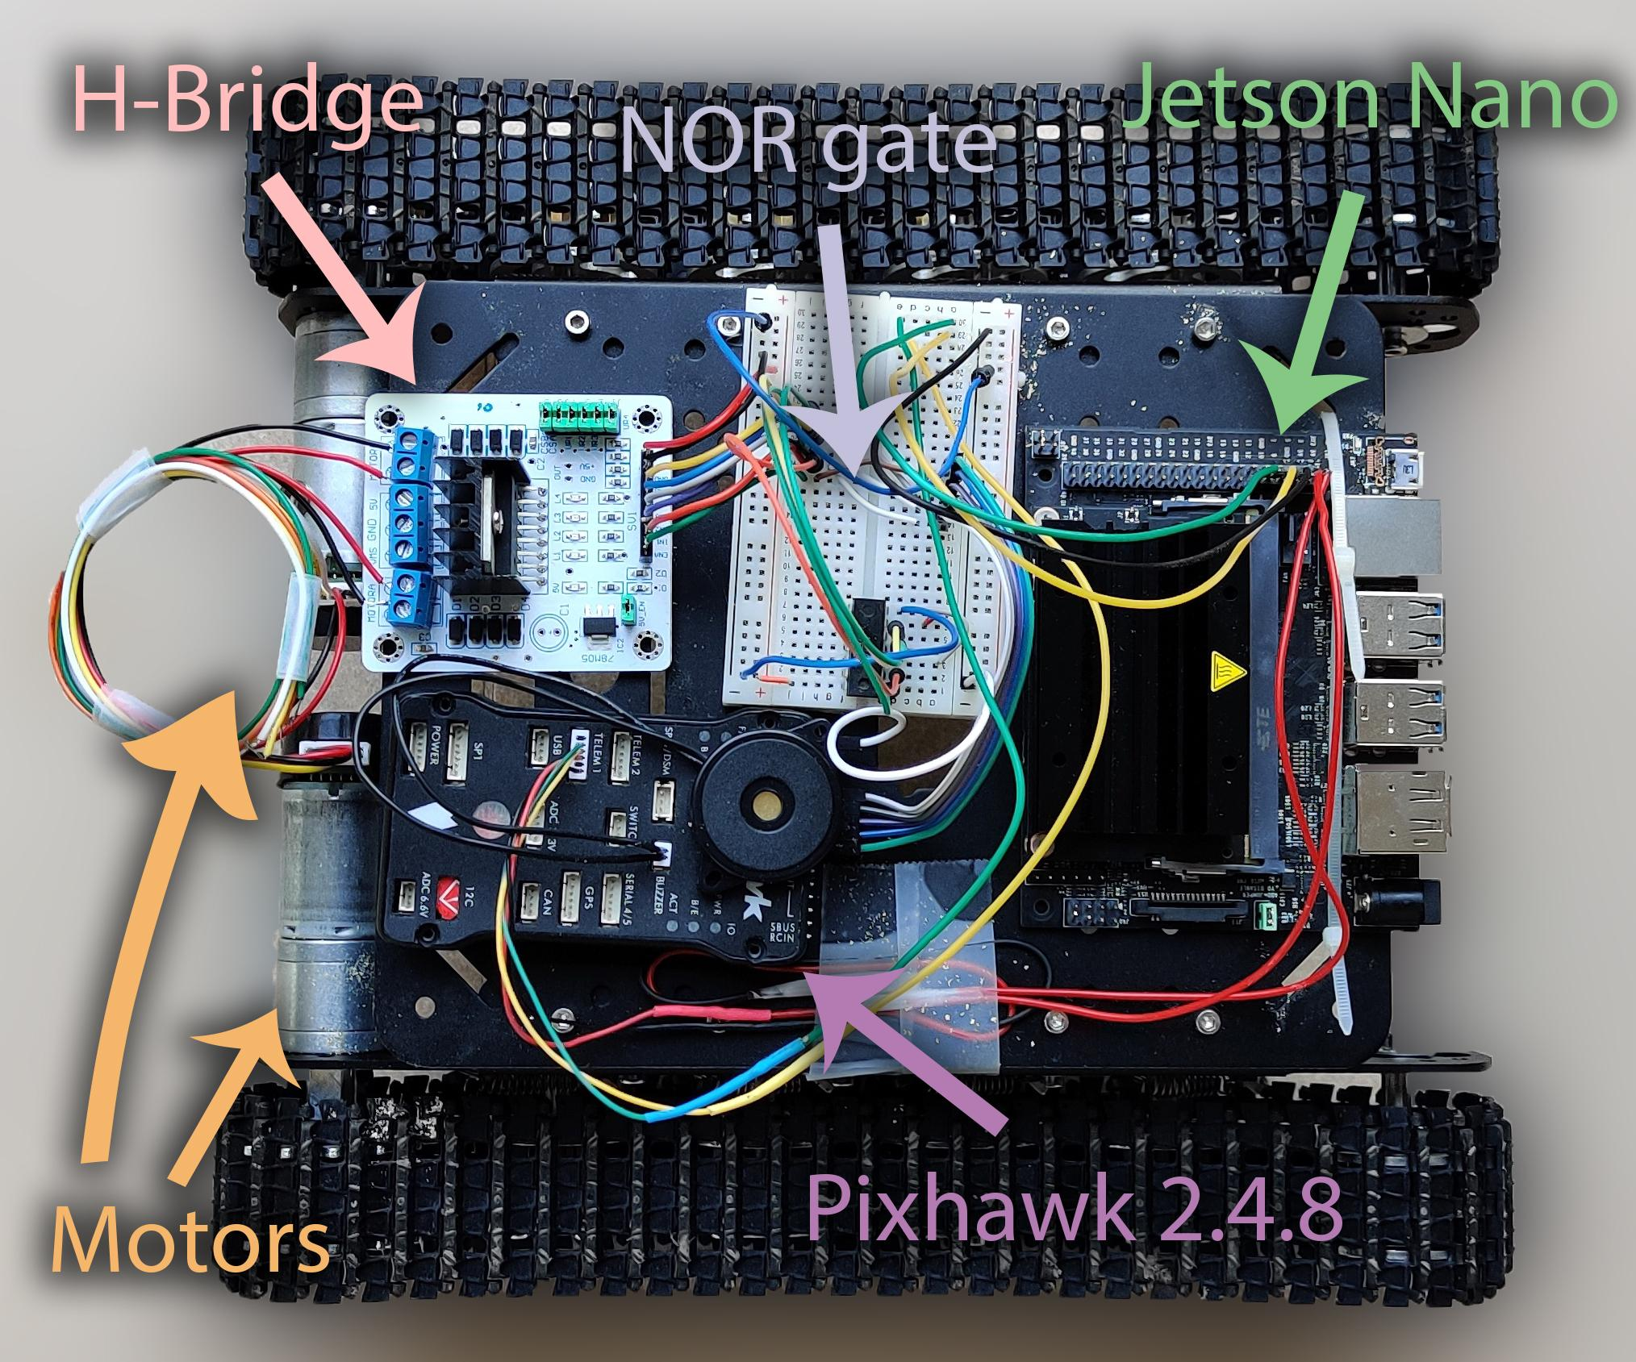

Slide 34
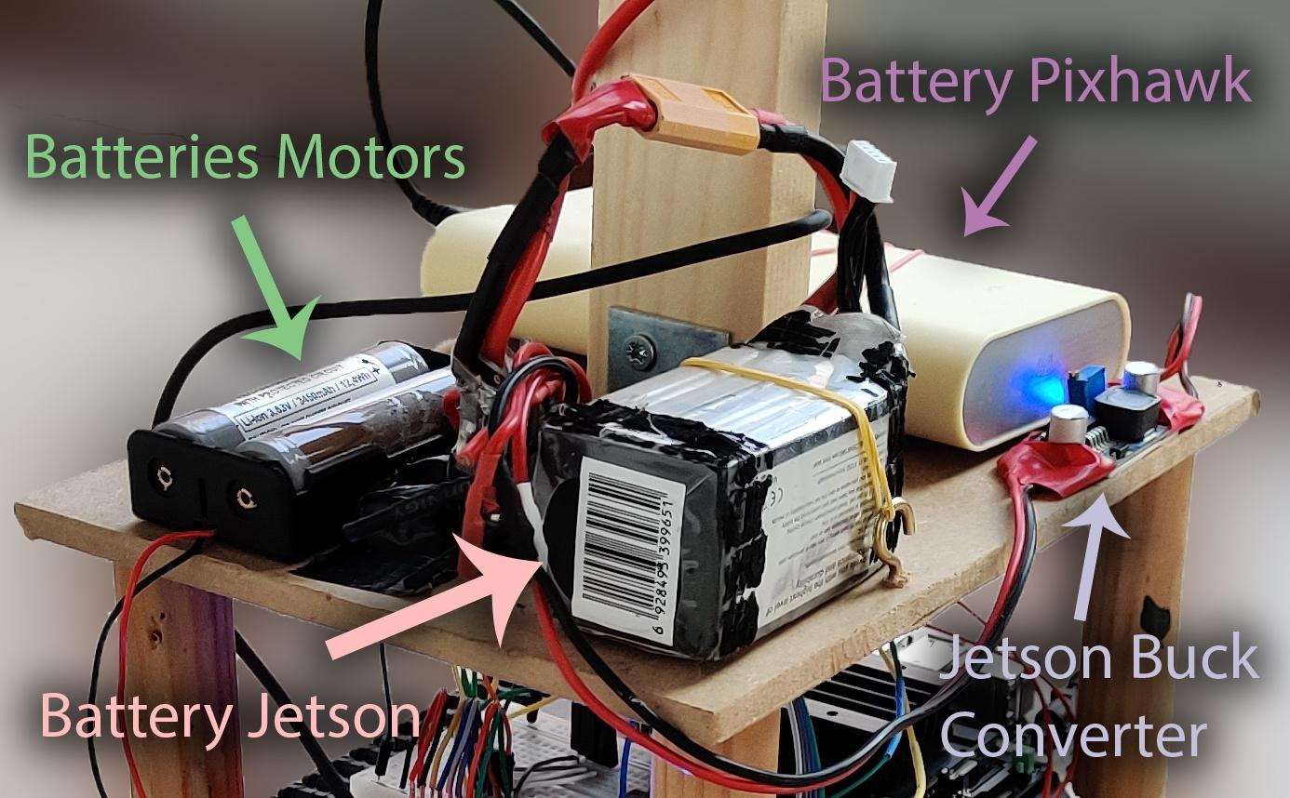

Slide 35
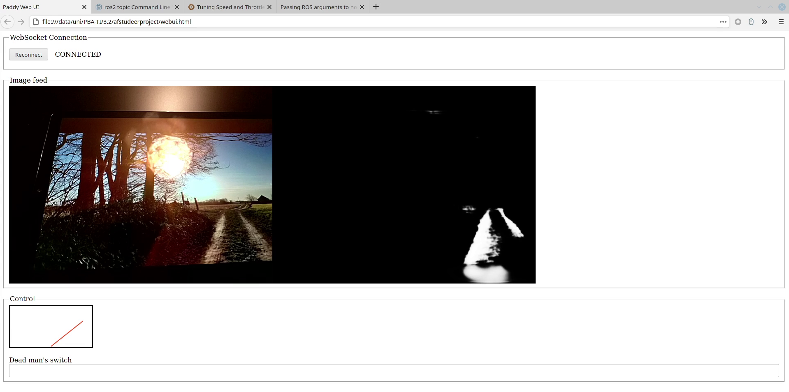

Slide 36
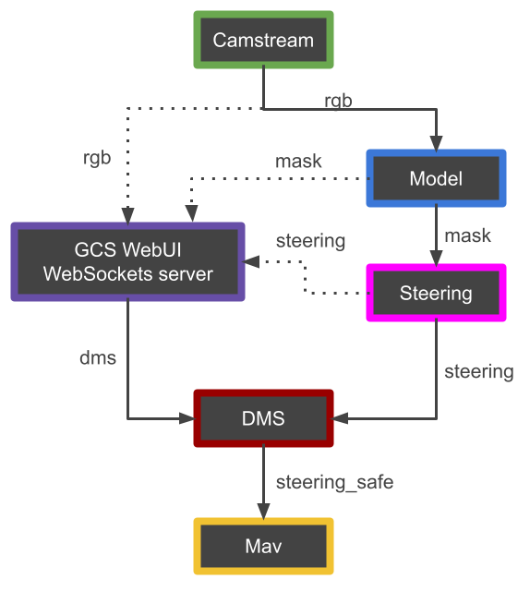
Functional Diagram ROS
Notes:
INFERENTIE NYET OP JETSON => Plug an play websockets
DMS REWRITE

Slide 38
Conclusion

Slide 39
Further improvements
On-drone inference
More environments
Autonomous decision making
...

Slide 40
Applications
Surveying
Transport
Remote assistance
...

Slide 41
Autonomously Following Forest Paths with a Mobile Robot using Semantic Segmentation
Pieter Fiers r0708591
Simon Germeau r0708896
paddy.pfiers.net

